Slide 1
The Biology of Memory
Allan L Bernstein M.D.

Slide 2
Memory
Registration
  Attention sufficient to start storage
Encoding-creates the memory: occurs with ‘quality’ sleep
Consolidation-time to set up storage: needs intact brain structures
Retrieval: Slows down with age-normal

Slide 3
Attention is Key
Not interested
Medications
Poor sleep
Awareness of the environment
Alcohol (how much?)
Impaired hearing or sight
Depression
Pain

Slide 4
Attention
Gradual loss of hearing
Gradual loss of vision
Loss of smell
Loss of taste
Fear of falling may lead to social isolation

Slide 5
Medications
Chemotherapy “chemobrain”
Antihistamines including OTC meds
Sleep medications
Anticholinergics
Anti anxiety medications
Narcotics
Other pain medications
Sea sick patches

Slide 6
Conflicting/Competing
Pain interferes with memory
Pain meds also interfere
Poor sleep interferes with memory
Most sleeping pills interfere with memory
Behavior modification or other non-drug treatments?

Slide 7
Storage
Intact brain essential from cross communication
  Strokes
  Trauma
  Scar tissue from infections
  COVID?

Slide 8
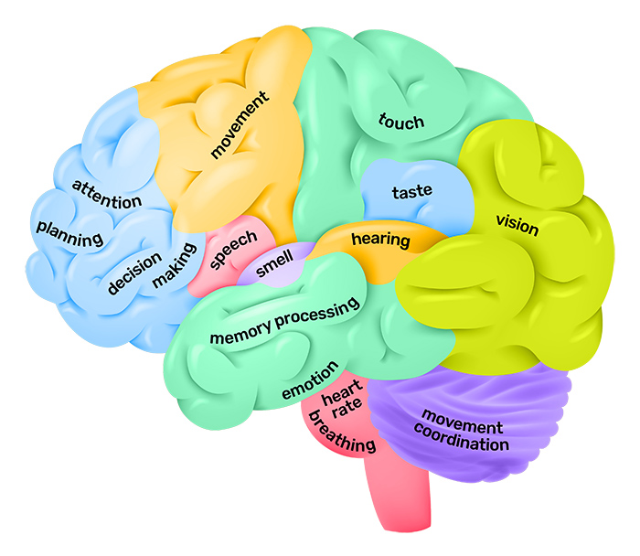

Slide 9
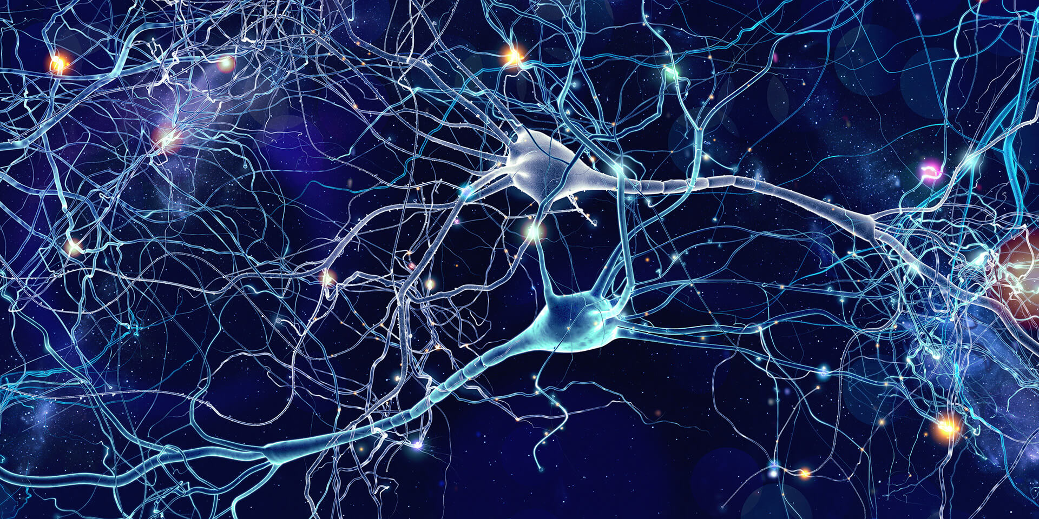

Slide 10
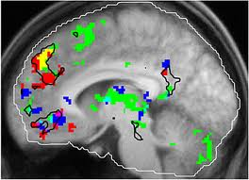
Pet scan of brain areas activated by music

Slide 11
Neurotransmitters
Dopamine: stimulus, feel good, emotion, movements
Serotonin: ten different sub types, involve depression, mood, migraine, etc
Acetylcholine: triggers muscle activity, decreased in Alzheimer’s
Norepinephrine: stimulates multiple systems, helps sleep, dreams
GABA: pain modulation, inhibits other neuron connection
Glutamate: excitatory, helps memory
CGRP: pain and muscle activity
Endorphins : pain modulation, sense of well being

Slide 12
The chemistry of memory
Oxygen
Glucose- a double edge sword
Ketones
Vitamins
Minerals
The brain is energy dependent 24/7. It does NOT slow down during sleep

Slide 13
How does memory fail?
Structural damage interrupts pathways (i.e., strokes)
Lack of oxygen (strokes, drowning, heart attacks)
Infections/inflammation (? COVID)
Frequent trauma creates cumulative damage (boxers, football players)
Toxic chemicals (lead, mercury)
Degenerative processes

Slide 14
Progressive cognitive decline equals dementia
Dementia is progressive and a change from previous status
It can have multiple causes such as alcohol, drugs, strokes
It effects multiple systems including memory, judgement, orientation, mood, executive function, speech and language

Slide 15
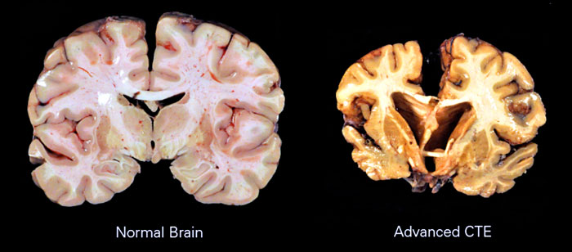
Football players/Boxers

Slide 16
Alzheimer’s disease is a specific type of dementia
Described by Alois Alzheimer in 1907
Based on a 51 year old woman he follow for a number of years with progressive memory loss and personality changes
Neuropatholgy studies showed
  Amyloid plaque
  Neurofibrillary tangles

Slide 17
What is amyloid
A lipid-like material essential to many functions in the body and the brain
Three forms, all starting with APP (amyloid precursor protein)
  Various enzymes cleave the protein into amino acid units, 38 units long, 40 units long and 42.
  The 42 is the one that ‘clumps’ and precipitates into the brain tissue

Slide 18
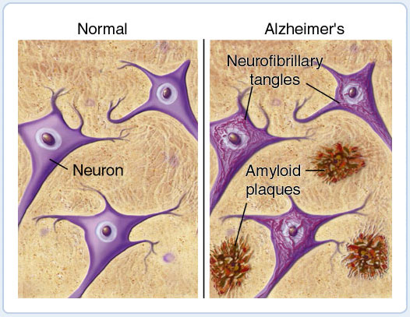

Slide 19
Clinical diagnosis until recently was “best guess”
Every gradually progressive dementia was considered likely Alzheimer’s
Positive diagnosis could only be made at autopsy
We were right about half the time

Slide 20
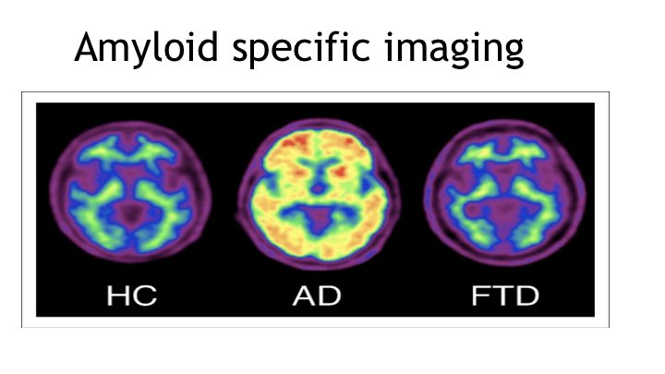
We can identify Alzheimer’s disease in real time using PET imaging

Slide 21
Other diagnostic tests
Spinal fluid (CSF)
  Amyloid
    Is low in AD
  Tau is high
Blood test for tau
PET scan for Tau
Genetic testing for APOE

Slide 22
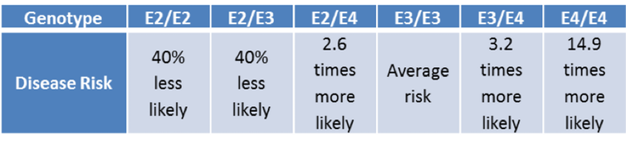
APOE genes and risk of Alzheimer’s Disease

Slide 23
Can we treat dementia?
Finding a cause, i.e., medications, sleep disorders, toxic chemicals that can be modified.
Treat hearing loss, depression, isolation
Reduce alcohol

Slide 24
Can we treat Alzheimer’s?
Focus has been on Amyloid
  Vaccines against amyloid didn’t work
  Antibodies against amyloid haven’t worked so far
  Drug to lower production of amyloid haven’t worked

Slide 25
Can we treat Alzheimer’s without focus on amyloid?
Estrogen-like drugs didn’t work
Vitamins didn’t work
Nicotine may be preventive, but didn’t work in treatment
Anti-Inflammatory medications may work, still in testing i.e. ibuprofen
Cannabis can’t be tested in the current research environment

Slide 26
The newer drugs
Aricept (donepazil), has been around 25 years. It increased acetylcholine in the brain and gives transient improvement. Exelon is similar
The newer monoclonal antibodies, lecanamab, donanamab reduce amyloid and slow decline
They do NOT cure the disease
Further studies using them as preventives are needed

Slide 27
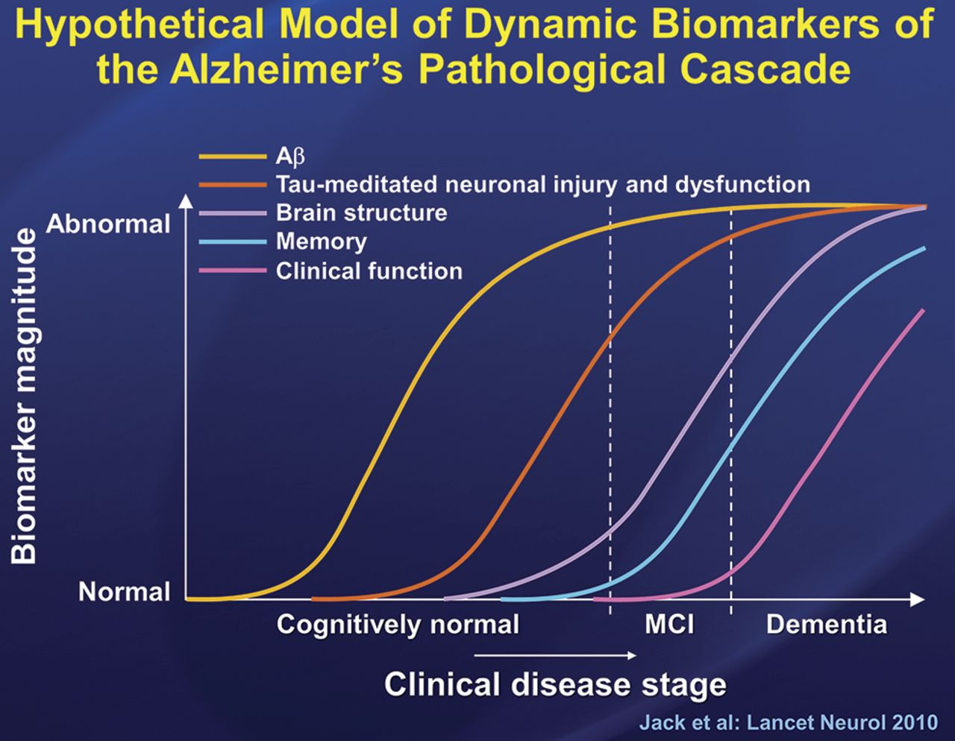

Slide 28
Blood flow and Dementia
Interfering with blood flow causes memory loss
  I.e., strokes
Increasing blood flow to the smaller vessels may reduce toxic chemicals including tau and amyloid
Recent data on use of Viagra suggests it may be neuroprotective

Slide 29
Prevention Strategies
Increased education-continuing
Managing blood pressure
Managing diabetes
Take care of your heart
Stay socially active
Ketogenic diets
Physical activity
Dental care
Sleep quality

Slide 30
QUESTIONS?

Slide 31
Speech
Tone
Modulation
Accents
Loudness
Cadence
Emotion

