Slide 1

#CountMeIn:
Making the Census Count
for Community Action
Oakmont Symposium
Sunday, April 7, 2020
Jim Masters
National Community Action Partnership
Center for Community Futures

Slide 2
Disruptions and Delays
Nothing new here. In recent decades, the census in the U.S. has experienced major delays, in 1940, 1960, 1980.
More on the disruptions and delays in the 2020 census later in the presentation.

Slide 3
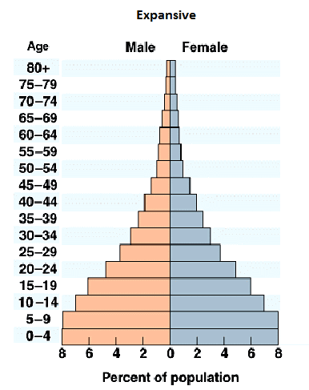
Population Pyramid Historic

Slide 4
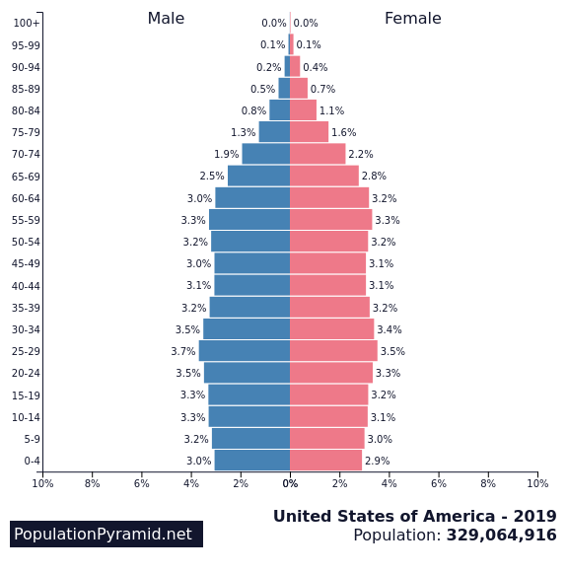
Population Pyramid U.S. 2019

Slide 5
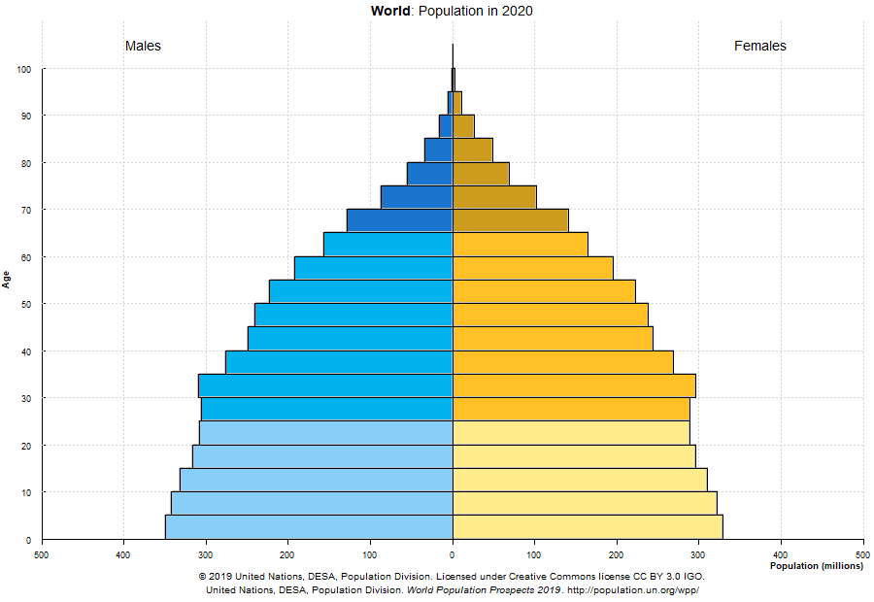
World population 2020

Slide 6
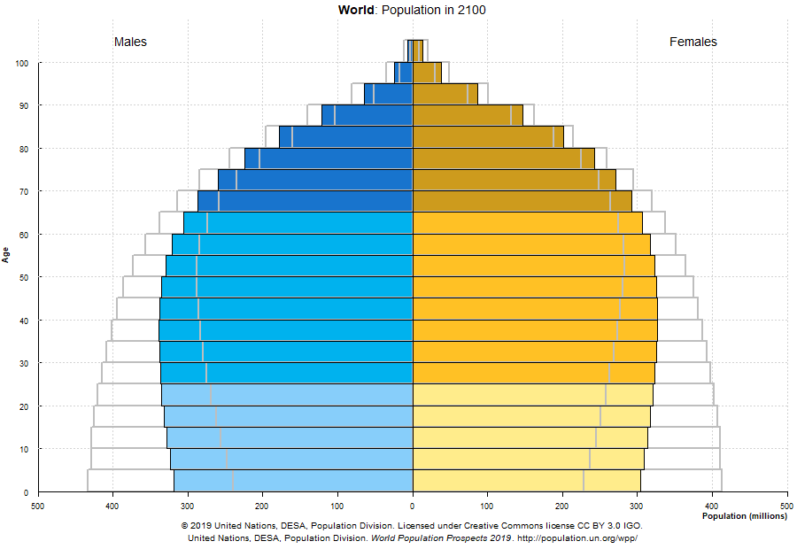
World population 2100 https://population.un.org/wpp/Graphs/DemographicProfiles/Pyramid/900

Slide 7
Pop/Housing counts R-O-W
Since 1945 and U.N guidance, almost all countries conduct a census doing direct counts of the population. Some experience delays
A few countries are switching to using administrative data: Netherlands, Norway, Sweden, Switzerland, Denmark.
A few countries lag. Lebanon, not since 1932. Afghanistan, 40 years. Eritrea, Madagascar, DRC and Uzbekistan not since 1990.

Slide 8
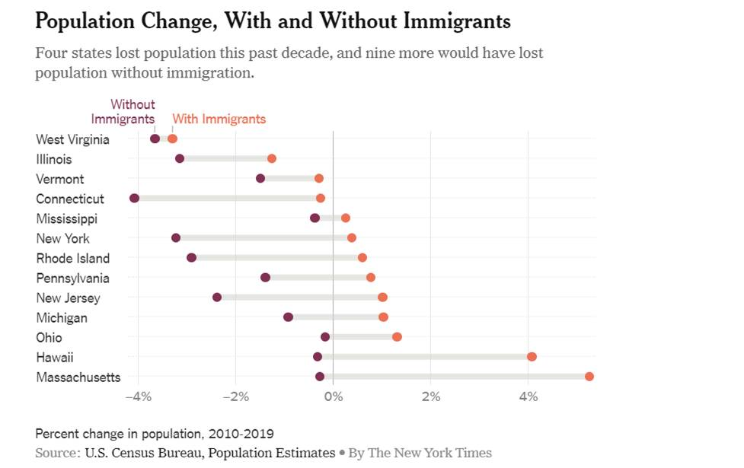

Slide 9
Agenda
What is the Decennial Census?
Why does the Census matter to us?
What the Census Bureau is doing.
What Get Out the Count is doing.
The Democracy Project
Next Steps and Questions
Notes:
This presentation has a number of objectives.
Provide an overview of the Census, what it is, why its important, and what to expect.
Additionally, we will lay out information about all of the current Census Outreach efforts, from the Census Bureau to the Census Campaign, and the Partnership’s efforts.
We will discuss what steps can be taken now at the local level to start engaging your communities around the census
Most importantly we aim to form a dialogue where we can hear your most pressing questions about the Census, and answer when we can, and also hear from you about practices in your community that are already taking place or have taken place in the past to Get out The Count, which we hope to amplify across the network

Slide 10
The decennial census counts the total population
Notes:
Census is constitutionally mandated

Slide 11
“Representatives and direct Taxes shall be apportioned among the several States which may be included within this Union, according to their respective numbers, counting the whole number of persons in each State.
The actual enumeration shall be made…within every subsequent term of ten years, in such manner as they shall by law direct”
  US Constitution, Article 1, Section 2*
*Language adjusted to reflect Amendment XIV, Article II to US Constitution, July 9, 1868
Notes:
The census is rooted in the constitutional principle of representative democracy, where population is the basis for shared political power
The census aims to count the entire population of the country where they live, this includes all people regardless of age or citizenship status.
A count of the population every 10 years is mandated by the Constitution, and it is required by law to respond.
Governed by Title 13 of the US Code of Federal Regulations (CFR): Title 13 provides the following protections to individuals and businesses:
Private information is never published. It is against the law to disclose or publish any private information that identifies an individual or business such, including names, addresses (including GPS coordinates), Social Security Numbers, and telephone numbers.
The Census Bureau collects information to produce statistics. Personal information cannot be used against respondents by any government agency or court.
Census Bureau employees are sworn to protect confidentiality. People sworn to uphold Title 13 are legally required to maintain the confidentiality of your data. Every person with access to your data is sworn for life to protect your information and understands that the penalties for violating this law are applicable for a lifetime.
Violating the law is a serious federal crime. Anyone who violates this law will face severe penalties, including a federal prison sentence of up to five years, a fine of up to $250,000, or both.

Slide 12
Census Data is Used To…
Apportion the numbers of representatives among states.
Redistricting by states. New lines for congressional and state legislative districts, school districts, et. al.
Distribute federal dollars to states.
Inform government planning decisions at the federal, tribal, state and local level
Inform organizational decisions of businesses and non-profits (e.g., characteristics of populations , where to locate, etc.)
Enforce voting rights and civil rights legislation
Notes:
This slide is straightforward but when touching on the bullets of Distribution of Funds, Informing Gov. Planning, and Informing Org. Decisions, this is a good opportunity to connect to functions of Community Action.

Slide 13
50 ways census data are used https://www.tsl.texas.gov/sites/default/files/public/tslac/ld/census2020/50Ways.pdf

Slide 14
2020 Census Economics
The Census Bureau will spend over $15 BILLION to complete the count. About 7 billion has been spent, and 7.3 billion will be spent in 2020. Now, “fully funded.”
The average cost for counting a household:
  2020: $107
The bureau is hiring about 500,000 people for the 2020 Census. (Bureau civil servants = 4,265)
Every person counted is equal to $2,441.54 in federal funding to California – each year, for ten years!
Notes:
The Census if the biggest non-war governmental field operation. It requires a huge investment in both dollars and man power. It can be a generator of temporary local jobs in your community, and the results have a major impact on funding to your community for a decade.

Slide 15
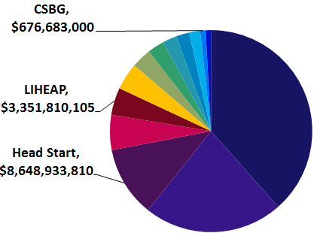
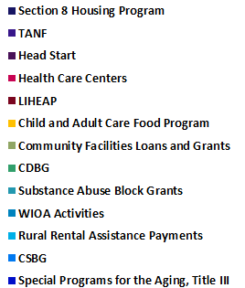
Census Data Drives Dollars
In 2016, 15 federal programs most used by CAAs relied on Census data to distribute $77 billion or 9% of $864 billion total federal program spending
Notes:
This slide is self explanatory, but important to note that the programs depicted here are not alll the programs that are impacted by the Census, just the ones that are most commonly utilized by Community Action. Worth noting out that the Weatherization program is one that is not included in this data

Slide 16
The Census Bureau Goal
“The goal of the 2020 Census is to count everyone once, only once, and in the right place.”
Operational Plan V4. https://www.census.gov/programs-surveys/decennial-census/2020-census/planning-management/planning-docs/exe-sum.html

Slide 17
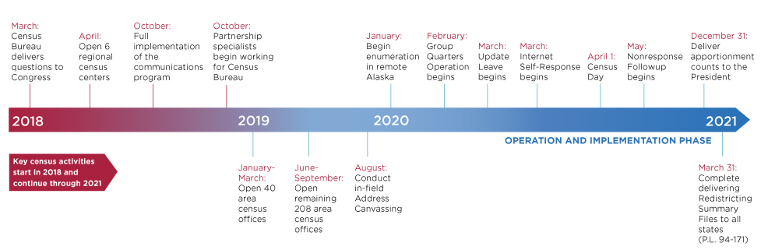
The 2020 Census
Operational Timeline
Notes:
Self-Response phase:
Census Bureau mails information about the decennial questionnaire to almost all households (before April 1, 2020).
For 2020, some households will be mailed the actual questionnaire, most households will be mailed an online link to fill out the form, & everyone will have the opportunity to mail in the form if they choose not to fill it out online.
The most accurate & complete population data is submitted during this phase.
Non-Response Follow Up phase: Begins May of 2020
The Census Bureau hires 100s of thousands of people to go door-to-door to count every household that didn’t self-respond (after April 1, 2020).
Much more expensive than the self-response phase ($2 BILLION in 2010).
During this phase, the risk is greatest that people will be missed and the count will be inaccurate.
Areas with large shares of households that don’t self-respond are therefore “hard to count”. Almost every community will have some households that don’t self-respond. But some communities have as many as half of their households that need to be counted in person. We’ve mapped these communities to help ensure a fair and accurate 2020 Census.

Slide 18
2020 Census
Counting The Population - Methods
95% of households will receive a letter with instructions about how to fill out the form online, or how to call the CQA center.
5% of households will have the letter dropped off.
Less than 1% of households will initially be counted in person by a census enumerator
The goal is to have 60% respond online.
An estimated 40% of households will require follow up by an enumerator. They don’t call, they visit.
Notes:
All households will receive a letter asking to complete the census online, areas less likely to respond online will also receive a paper questionnaire. 6 attempts for in person follow up: 3 in person, 3 proxy
After 6 attempts, secondary sources will be used

Slide 19
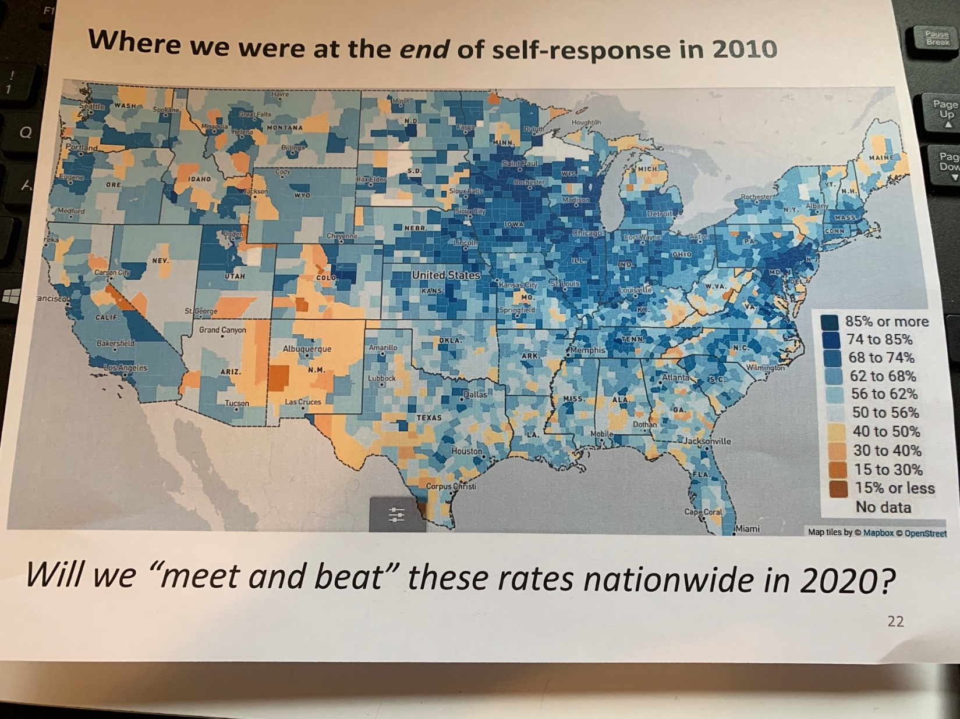

Slide 20
Tracking Self Response
Find weekly reports on response rates by geographic area, click here:
https://2020census.gov/en/response-rates.html?utm_campaign=20200327msc20s1ccallnl&utm_medium=email&utm_source=govdelivery

Slide 21
CUNY Weekly Response Rate
Maps
https://www.censushardtocountmaps2020.us/

Slide 22
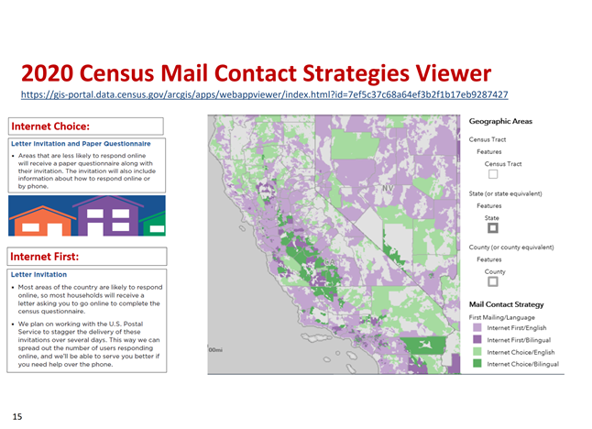
Mailing Strategies

Slide 23
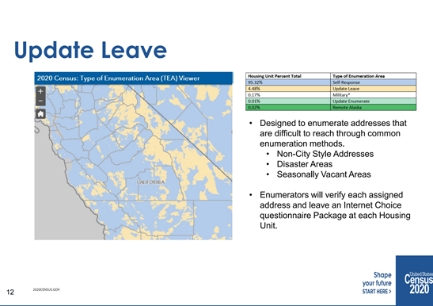
Update Leave

Slide 24
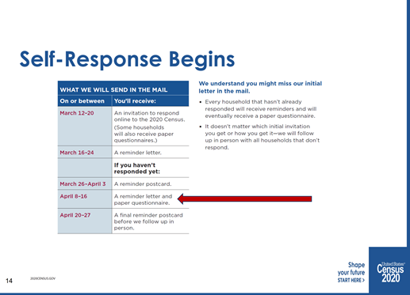
Self Response Begins www.my2020census.gov

Slide 25
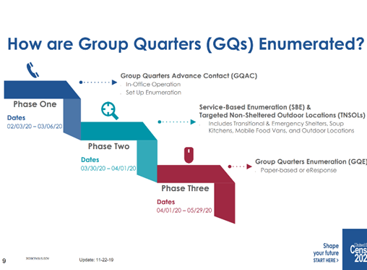
Group Quarters

Slide 26
Group Quarters: Enumeration Methods
Electronic (e Response)
Paper data collection options
  In person interview by enumerators
  Facility self-enumeration
  Drop off/pick up

Slide 27
Group Quarters: Important Dates
Conduct Advance Contact: 2/3/20 to 3/6/20
2/3 e-response or self, 1/3 send enumerators
Group Quarters Enumeration: 4/1/20 to 6/12/20
5/14/20 to ??

Slide 28
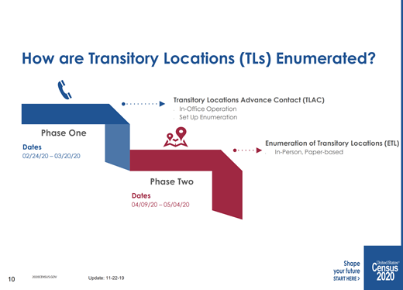
Transitory Locations

Slide 29
Questionnaire Assistance
Questionnaire Assistance Centers toll free numbers starting March 9, 2020 in 13 languages
https://www.census.gov/programs-surveys/decennial-census/2020-census/planning-management/memo-series/2020-memo-2019_18.html
Mobile Assistance Centers

Slide 30
COVID 19 aka Coronavirus
Census deadline has been moved to August 14th
Mobile Assistance Questionnaire centers are delayed to 4/13
NRFU has been pushed back to 5/28
College Kids
Group Quarters visits delayed to mid April
Homeless populations (living on streets, in cars, motels, RVs) Trying service based enumeration

Slide 31
2020 Census
Counting The Population – Key Dates
March 12-20: Invitations mailed to respond online
March 16-April 3: Reminder letters and postcards sent
April 1: Census Day
April 8-16: Reminder letters sent with paper questionnaire
April 20-27: Final postcard sent before in person follow up
May 4-July 24: May 28 – August 14Non-Response follow up visit

Slide 32
What could happen
Add even more weeks for NRFU.
Extend hours/increase days of enumerators.
Media push.
Increased reliance on administrative records.
Emergency funding local governments/nonprofits
Unhappy reliance on making statistical adjustments with increasing margins of error.
Any or all of the above

Slide 33
The ten questions on the 2020 Census
If you provide an e-mail on the sign-up sheet, we will e-mail you a copy of the sample form.
Or you can download it from:
http://www.cencomfut.com/Census2020.html
This is an Informational copy ONLY. People cannot fill this out and mail it in and cannot fill it out and hand it to an Census Bureau employee.

Slide 34
The questions. Number of people

Slide 36
Question 5. For Each Person

Slide 37
Census questions for each person
Person 1 also provides the following information about each household member:
Name.
Relationship to Person 1.
Sex.
Age.
Date of birth.
Hispanic origin/ethnicity.
Race.

Slide 39
For each additional:
Relationship of person to person 1

Slide 40
Question 7. Age for each person

Slide 41
Question 8. Hispanic origin

Slide 42
Question 9. Race of each

Slide 43
What is this person’s race? Mark one or more boxes AND print origins.
White – Print, for example, German, Irish, English, Italian, Lebanese, Egyptian, etc. AND PRINT RACE OR ORIGIN
Black or African Am. – Print, for example, African American, Jamaican, Haitian, Nigerian, Ethiopian, Somali, etc. AND PRINT RACE OR ORIGIN
American Indian or Alaska Native – Print name of enrolled or principal tribe(s), for example, Navajo Nation, Blackfeet Tribe, Mayan, Aztec, Native Village of Barrow Inupiat Traditional Government, Nome Eskimo Community, etc. AND PRINT RACE OR ORIGIN
Chinese 5. Filipino 6. Asian 7. Indian AND PRINT RACE OR ORIGIN
Other Asian – Print, for example, Pakistani, Cambodian, Hmong, etc. C
Vietnamese. Korean. Japanese. AND PRINT RACE OR ORIGIN
Native Hawaiian. Samoan. Chamorro. Other Pacific Islander – Print, for example, Tongan, Fijian, Marshallese, etc. AND PRINT RACE OR ORIGIN
Some other race – Print race or origin

Slide 44
Race and ethnicity two separate concepts
The U.S. Census Bureau considers race and ethnicity to be two separate and distinct concepts. What is race? The Census Bureau defines race as a person’s self-identification with one or more social groups. An individual can report as White, Black or African American, Asian, American Indian and Alaska Native, Native Hawaiian and Other Pacific Islander, or some other race. Survey respondents may report multiple races.
What is ethnicity? Ethnicity determines whether a person is of Hispanic origin or not. For this reason, ethnicity is broken out in two categories, Hispanic or Latino and Not Hispanic or Latino. Hispanics may report as any race.
https://www.census.gov/mso/www/training/pdf/race-ethnicity-onepager.pdf

Slide 45
How are Race Data Used?
These include, among others:
Enforcing the requirements of the Voting Rights Act;
reviewing State congressional redistricting plans;
collecting and presenting population and population characteristics data, labor force data, education data, and vital and health statistics;
establishing and evaluating Federal affirmative action plans and evaluating affirmative action and discrimination in employment in the private sector;
monitoring the access of minorities to home mortgage loans under the Home Mortgage Disclosure Act;
enforcing the Equal Credit Opportunity Act;
monitoring and enforcing desegregation plans in the public schools;
assisting minority businesses under the minority business development programs; and
monitoring and enforcing the Fair Housing Act. Page 67401
https://www.federalregister.gov/documents/2016/09/30/2016-23672/standards-for-maintaining-collecting-and-presenting-federal-data-on-race-and-ethnicity

Slide 46
Bureau has done research on race since 1954
Interagency groups start three years before census
https://www2.census.gov/programs-surveys/decennial/2020/program-management/final-analysis-reports/2015nct-race-ethnicity-analysis.pdf

Slide 47
2020 Census uses the
1997 OMB definitions.
“The racial categories included in the census questionnaire generally reflect a social definition of race recognized in this country and not an attempt to define race biologically, anthropologically, or genetically. In addition, it is recognized that the categories of the race item include racial and national origin or sociocultural groups.” https://www.census.gov/topics/population/race/about.html

Slide 48
Title VI CRA
Race, Color, National Origin
From: “An Order Combatting Hate Revives Questions of Identify”
https://www.nytimes.com/2019/12/15/world/americas/trump-jews-executive-order.html
“…whether the movement toward hardened, national-style identities is the solution to their problems – or is the problem itself.”

Slide 49
Race from 1790 to 2020
https://www.census.gov/data-tools/demo/race/MREAD_1790_2010.html

Slide 50
For each additional: Usually live or stay somewhere else?

Slide 51
Question 6. Sex is still binary

Slide 52
Gender: ABC News found 58
Agender Androgyne Androgynous
Bigender Cis CisgenderCis Female
Cis Male Cis Man Cis Woman
Cisgender Female Cisgender Male Cisgender Man
Cisgender Woman Female to Male FTM
Gender Fluid Gender Nonconforming Intersex
Male to Female Gender Questioning Gender Variant Genderqueer
MTF Neither Neutrois
Non-binary Other Pangender
Trans Trans* Trans Female
Trans* Female Trans Male Trans* Male
Trans Man Trans* Man Trans Person
Trans* Person Trans Woman Trans* Woman
Transfeminine Transgender Transgender Female
Transgender Male Transgender Man Transgender Person
Transgender Woman Transmasculine Transsexual
Transsexual Female Transsexual Male Transsexual Man
Transsexual Person Transsexual Woman Two-Spirit

Slide 53
Language Guides
Guides about how to fill out the 2020 census form in 58 languages
https://www.census.gov/programs-surveys/decennial-census/2020-census/planning-management/language-resources/language-guides.html

Slide 54
Help people get a job at the Census Bureau
For types of jobs see:
https://www.census.gov/jobs
For all jobs apply online at:
https://recruitment.2020census.gov/ats/careersite/census.aspx?site=1&c=census

Slide 55
Data Protections
Since 1954, Title 13 of the U.S. Code , PROHIBITS release of data on individuals for any purpose at all for 72 years. Provides penalties of $250,000 and five years in prison. No Census Bureau employee ever charged.
Corporate culture: the Bureau’s civil servants know that public confidence rests on them protecting privacy. They are committed to doing that; strong corporate culture.

Slide 56
Possible Privacy Invaders?
NOT: FBI, ICE, local law enforcement, et. al. who are prohibited by Title 13.
Maybe U.S. commercial interests: Facebook vendors, Amazon, Google, Claritas, et. al.
Homeland Security/Patriot Act? 2010 DOJ memo being revised?
Foreign governments?
Miscellaneous hackers ?

Slide 57
Preserving confidentiality for 2020 census data
Relies on “differential privacy” (or “formal privacy”) to provide robust and measurable confidentiality protections against the evolving challenges from commercial providers using computer science and the growing availability of personal information online. The closer statistics match the underlying, confidential data, the greater the risk to the confidentiality of individual respondents. Differential privacy involves a trade-off between confidentiality and the utility of published statistics.
Georgetown Center on Privacy

Slide 58
E-Differential Privacy
Overview: https://censuscounts.org/wp-content/uploads/2019/11/GCPI-ESOI-Differential-Privacy-in-the-2020-Census-20191107.pdf
Introducing “jitter”. To understand the balance between “decent accuracy” and “decent privacy”
https://www.youtube.com/watch?v=pT19VwBAqKA

Slide 59
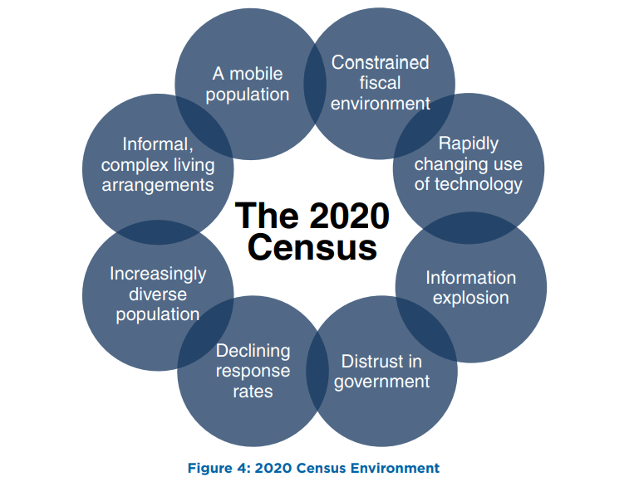
The 2020 Census- The Environment
Notes:
This slide is important. This slide’s purpose is to pivot from talking about how the Census Data is valuable to Community Action, to why making sure everyone is counted should be a concern for Community Action. The slide shows why this year in particular there are various factors that will make it difficult to ensure a complete count. And because we have already demonstrated why the Census is valuable to Community Action, this should be a big concern for Community Action, and is why we need agencies to do what they can to make sure people are counted. Below is an explanation of each circle:
• Constrained fiscal environment: Budget deficits place significant pressure on funding available for the research, testing, design, and development work required for successful innovation.
• Rapidly changing use of technology: Stakeholders expect the decennial census to use technology innovation, yet the rapid pace of change makes it challenging to plan for and adequately test the use of these technologies before they become obsolete.
• Information explosion: Rapid changes in information technology (IT) create stakeholder expectations for how the Census Bureau interacts with the public to collect data and disseminate data products.
• Distrust in government: The public’s concerns about information security and privacy, the confidentiality of information given to the government, and how government programs use the information they collect continue to grow. This impacts response rates and could make it more difficult for government agencies to collect important demographic survey information.
• Declining response rates: Response rates for Census Bureau surveys, and for surveys and censuses in general, have declined as citizens are overloaded with requests for information
and become increasingly concerned about sharing information.
• Increasingly diverse population: The demographic and cultural make-up of the United States continues to increase in complexity, including a growing number of households and individuals of Limited English Proficiency
• Informal, complex living arrangements: Households are becoming more diverse and dynamic, making it a challenge to associate an identified person with a single location. For example, blended families may include children
who have two primary residences.
• A mobile population: The United States continues to be a highly mobile nation as about 14.3 percent of the population moves in a given year

Slide 60
The Hard-To-Count Are:
New or forgotten housing
People trying to remain
hidden
Hard to Locate
Hard to Persuade
Suspicious of government
Not civically engaged
Undocumented
Misinformation
Hard to Contact
Hard to Interview
  Language barriers
  Low literacy
  No internet
  Unreliable mail
  Homeless
  Access barriers
  Transient communities
Notes:
Given this current environment, as well as what history of previous decennial census’ have shown us…we know that there will be certain groups of people that are hard to count. Which means they might not respond to the initial request to fill out the questionnaire and will likely require a non-response follow up. These groups are intersecting but broadly speaking these are the various categories that the hard to count fall into.

Slide 61
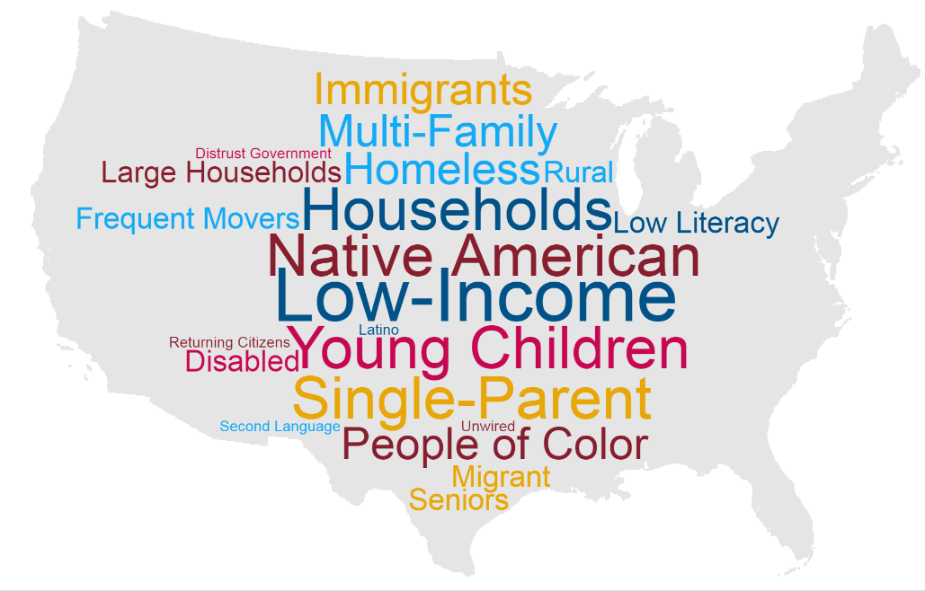
The Hard-To-Count Are:
Notes:
This means the hard to count population includes a variety of categories including:
Young children under the age of five.
Racial and ethnic minorities.
Non-English speakers.
Low income people.
People experiencing homelessness.
Undocumented immigrants.
People who distrust the government.
LGBTQ persons.
People with mental or physical disabilities.
People who do not live in traditional housing.
People who are members of disadvantaged or marginalized communities –with the most to lose – are at greatest risk of being uncounted. These are also the groups that are most likely to be served by Community Action

Slide 62
HTC in CA
38,168,482 people live in 12,888,128 households. 814,365 people live in group quarters. (Total pop = 38,982,847.)
About 40% are HTC @15,593,138
14 reasons why people are HTC:
No broadband, non-family roommates,<5, crowded, foreign born, limited English, not HS grad, receive PA, unemployed, recently moved from outside county, undocumented (2.5 m)

Slide 63
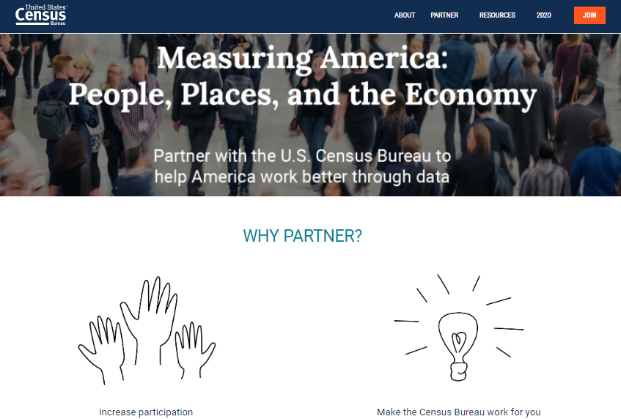
Be a partner with the Census Bureau:
https://www.census.gov/partners.html
Notes:
The Census Bureau is investing a large amount of their own resources to ensure thaat everyone is counted. On their website you can join this effort and stay informed about all of the resources they offer by becoming a partner to the US Census.

Slide 64
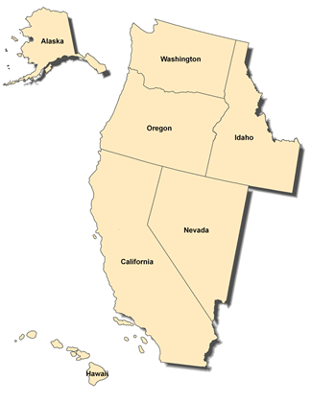
US Census Bureau: Partner Efforts
Your Regional Office
Julie Lam, Regional Director
Los Angeles Regional Office
15350 Sherman Way, Suite 400
Van Nuys, CA 91406-4224
(818) 267-1700 or 1-800-992-3530
FAX: (818) 267-1714
TDD: (818) 904-6249
E-mail:
Los.Angeles.Regional.Office@census.gov
Notes:
The Census Bureau is investing a large amount of their own resources to ensure that everyone is counted. On their website you can join this effort and stay informed about all of the resources they offer by becoming a partner to the US Census.

Slide 65
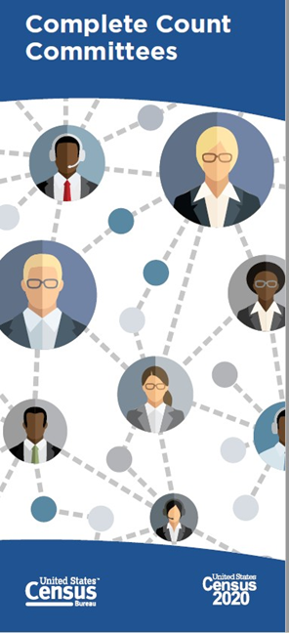
State/county Complete Count Committees (CCCs):
Utilize local knowledge and resources to promote the Census through locally based outreach efforts
Provide a vehicle for coordinating efforts between tribal, state, and local governments; communities; and the Census Bureau
Help the Census Bureau get a complete count through partnerships with local governments and community organizations
Find existing Complete Count Committees in your state/county on the Census website
Notes:
The Complete Count Committees (CCC) program is one of the main Get Out the Count efforts run by the Census Bureau. It is key to creating awareness in communities all across the country.
CCCs utilize local knowledge, influence, and resources to educate communities and promote the census through locally
based, targeted outreach efforts.
CCCs provide a vehicle for coordinating and nurturing cooperative efforts between tribal, state, and local governments; communities; and the Census Bureau.
CCCs help the Census Bureau get a complete count in 2020 through partnerships with local governments and community organizations.

Slide 66
CA CCC
State level: https://census.ca.gov/complete-count/
Region 8: https://www.unitedwaywinecountry.org/servlet/eAndar.article/4/United-Way-of-the-Wine-Country

Slide 67
County/City
Complete Count Committees (CCCs):
Utilize local knowledge and resources to promote the Census through locally based outreach efforts
Provide a vehicle for coordinating efforts between tribal, state, and local governments; communities; and the Census Bureau
Help the Census Bureau get a complete count through partnerships with local governments and community organizations
Find existing Complete Count Committees in your state/county on the Census website
Notes:
The Complete Count Committees (CCC) program is one of the main Get Out the Count efforts run by the Census Bureau. It is key to creating awareness in communities all across the country.
CCCs utilize local knowledge, influence, and resources to educate communities and promote the census through locally
based, targeted outreach efforts.
CCCs provide a vehicle for coordinating and nurturing cooperative efforts between tribal, state, and local governments; communities; and the Census Bureau.
CCCs help the Census Bureau get a complete count in 2020 through partnerships with local governments and community organizations.

Slide 68
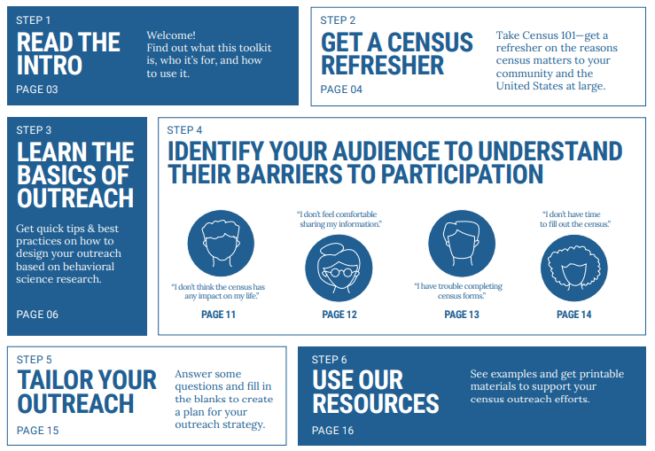
Census Bureau Outreach Toolkit https://www.census.gov/partners/toolkit.pdf
Notes:
One of the most helpful resources put together by the Census Bureau at this point is their partner outreach toolkit. This toolkit offers a basic overview of the census, discusses some of best practices for outreach, discusses some of the major barriers to participation with outreached tailored to meet those barriers, and then offers some promotional and informational resources to help support local outreach efforts.

Slide 69
Sonoma County CCC
https://sonomacounty.ca.gov/CAO/Census-2020/Complete-Count-Committee/

Slide 70
That concludes what the Census bureau is doing
In addition to the Census Bureau:
The Democracy Project
With support of 90 foundations

Slide 71

Strengthen Democracy
Three Pillars of Democracy
Democracy
Census
Redistrict
ing
Voting

Slide 72
The Democracy Project
Census Counts 2020
Rules for voter registration and voting
Redistricting

Slide 73
Democracy Funders Collaborative Census Subgroup
Annie E. Casey Foundation
Bauman Foundation
Carnegie Corporation Democracy Fund
Ford Foundation
The James Irvine Foundation
Joyce Foundation
JPB Foundation
Open Society Foundation
Wallace H. Coulter Foundation
Robert Wood Johnson Foundation
The William and Flora Hewlett Foundation

Slide 74
Pillar 1. Census
Persuade people who are hard-to-count to participate in the 2020 Decennial Census.

Slide 75
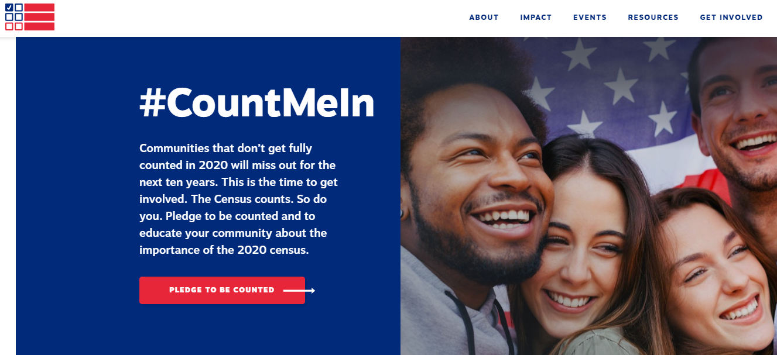

Census Counts 2020
visit www.CensusCounts.org - take the pledge to be counted and educate your community about the Census!
Notes:
April 1st of this year (one year out from Census Day) the Census Counts Campaign held a Census Day of Action. This was the largest effort of the campaign to date. Among the many activities of that day, the campaign officially launched their website: censuscounts.org, where thousands of people across the country had the ability to pledge to be counted and work towards a fair and accurate census. You can still visit and take the pledge and censuscounts.org, this will sign you up for important campaign updates and tie to a community of thousands already working on census outreach efforts. Additionally, the website is valuable resources to learn more about the various national partners involved in the Census Counts campaign as well as a continually updated list of resources to help with your outreach efforts.

Slide 76

















https://censuscounts.org
http://www.cencomfut.com/Census2020.html for list of hubs
Notes:
The Census Counts Campaign is a national collaborative effort funded by some of the nations largest foundations and funding organizations. These funders have come together to make a very large scale investment to help complement the census bureau’s outreach efforts to gauntness that the 2020 census is fair and accurate. The Census Counts campaign is lead by the Leadership Conference Education Fund alongside a growing number of national hub organizations that represent various hard to count groups (partnership for america’s young children, color of change, naleo) or networks of important stakeholders (state voices, ready nation, faith in public life)

Slide 77
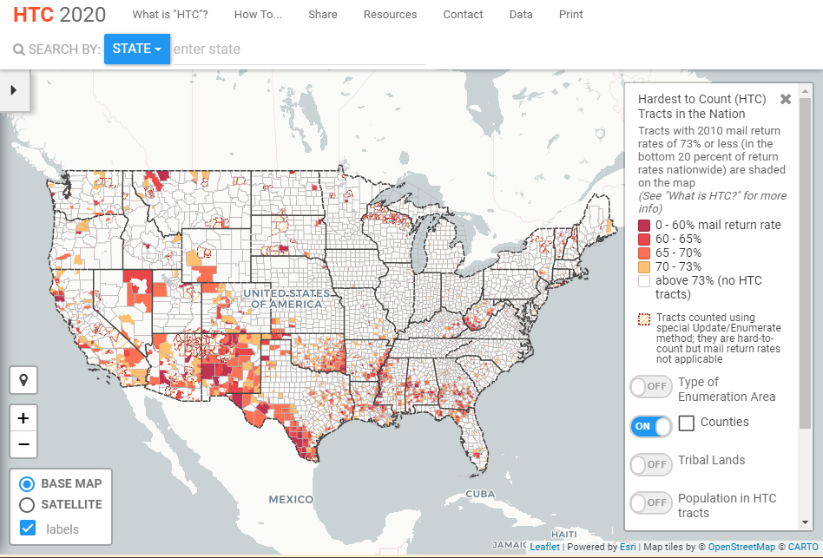
Finding The Hard To Count
www.CensusHardToCountMaps2020.us

Slide 78
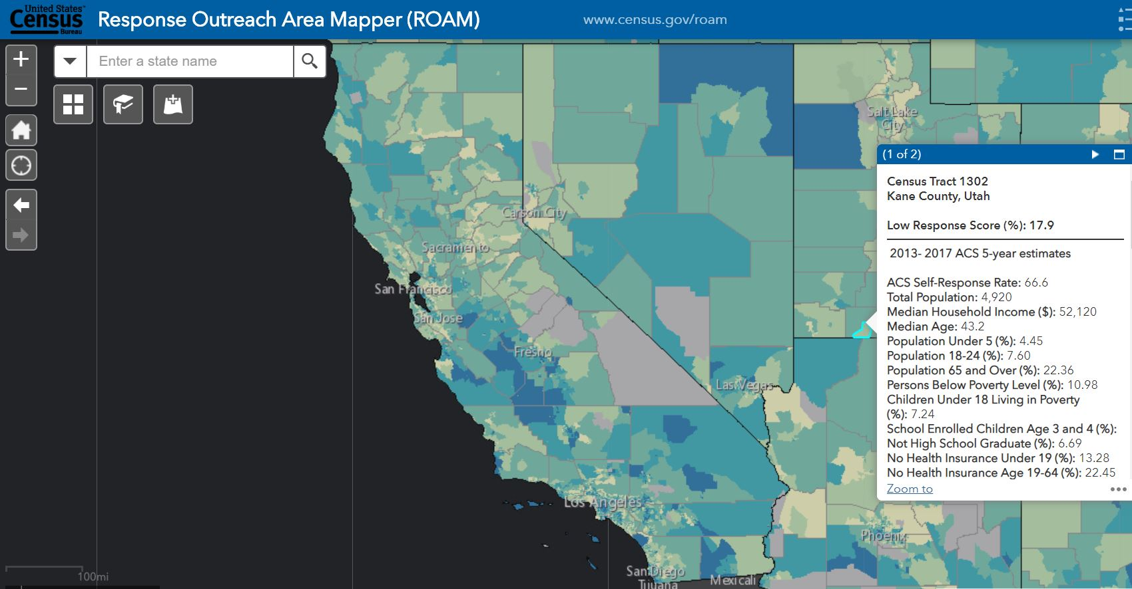
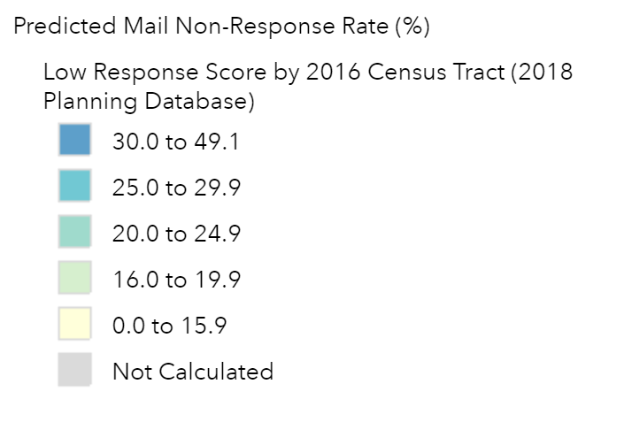
www.Census.gov/ROAM

Slide 79
Common Concerns & Answers
Why is the Census important?
  The Census helps the community get its fair share of federal and state resources, especially for children.
    Specific programs such as LIHEAP, Head Start, WIC, etc.
    For every person not counted, it is estimated our communities could lose an average of $2,400 per person of funding for each of the next ten years
Notes:
Discuss additional videos/tools/resources “These are some examples”

Slide 80
Common Concerns & Answers
Do I participate if I am not a citizen?
  Yes, the US Constitution says that the Census should count every person, whether citizen or not.
    Federal money and creation of districts are both based on total size of population, not just citizens.
    There a number of safeguards in place to protect the privacy of data people provide to the census, including citizenship status.
Notes:
Discuss additional videos/tools/resources “These are some examples”
CONFIDENTIALITY! Title 13 provides the following protections to individuals and businesses:
Private information is never published. It is against the law to disclose or publish any private information that identifies an individual or business such, including names, addresses (including GPS coordinates), Social Security Numbers, and telephone numbers.
The Census Bureau collects information to produce statistics. Personal information cannot be used against respondents by any government agency or court.
Census Bureau employees are sworn to protect confidentiality. People sworn to uphold Title 13 are legally required to maintain the confidentiality of your data. Every person with access to your data is sworn for life to protect your information and understands that the penalties for violating this law are applicable for a lifetime.
Violating the law is a serious federal crime. Anyone who violates this law will face severe penalties, including a federal prison sentence of up to five years, a fine of up to $250,000, or both.

Slide 81
Common Concerns & Answers
Do they come to my house?
  If you do not complete the Census form by the due date, a census staff member will visit your home to conduct the census in person. They will not enter your home.
    You will get a letter in the mail, with instructions on how and when to complete the census
    Census Bureau staff who have access to personal information are sworn to life to protect confidentiality
Notes:
Discuss additional videos/tools/resources “These are some examples”

Slide 82
Common Concerns and Answers
Is it safe for me to provide my information?
  Yes.
    Under the law, Census data can only be used for statistical purposes.
    Personal census information cannot be disclosed for 72 years (including names, addresses, and telephone numbers, and citizenship status)
    Census Bureau staff who have access to personal information are sworn for life to protect confidentiality. (Title 13 of the USC)
Notes:
The Census is Private and Confidential
Federal Law Protects Your Information. The U.S. Census Bureau is bound by Title 13 of the United States Code. This law not only provides authority for the work of the Census Bureau, but also provides strong protection for the information it collects from individuals and businesses. As a result, the Census Bureau has one of the strongest confidentiality guarantees in the federal government.
It is against the law for any Census Bureau employee to disclose or publish any census or survey information that identifies an individual or business. This is true even for inter-agency communication: the FBI and other government entities do not have the legal right to access this information. In fact, when these protections have been challenged, Title 13's confidentiality guarantee has been upheld.

Slide 83
Common Concerns and Answers
Can I help someone fill out their census form?
  Yes., up to a point.
    As a CAA staff member, you CAN help a person get online and pull up the proper form.
    You can sit with a person and read the informational form with them prior to their completing it.
    You CANNOT fill out the form for them or watch them fill it out. A family member can help them fill out the form online or on paper, or they can call the 800 number and provide their information over the phone.
Notes:
Discuss additional videos/tools/resources “These are some examples”

Slide 84
More on messaging
Bureau info “Census Barriers Attitudes and Motivators Study” https://www.census.gov/programs-surveys/decennial-census/2020-census/research-testing/communications-research/2020_cbams.html
New info from other hubs
New videos

Slide 85
Facebook/Instagram policy
Our census interference policy will prohibit:
Misrepresentation of the dates, locations, times and methods for census participation;
Misrepresentation of who can participate in the census and what information and/or materials must be provided in order to participate;
Content stating that census participation may or will result in law enforcement consequences;
Misrepresentation of government involvement in the census, including that an individual’s census information will be shared with another government agency; and
Calls for coordinated interference that would affect an individual’s ability to participate in the census, enforcement of which often requires additional information and context.

Slide 86
For rumors. Rumors@census.gov
Lawyers’ Committee: (888)-COUNT20 or (888)-268-6820
Arab American Institute: (833) 333-6864; (833)-3DDOUNI
● Asian Americans Advancing Justice AAJC: (844) 2020-API or (844) 202-0274
● NALEO Educational Fund: (877)-EL-CENSO or (877)-352-3676

Slide 87
Pillar 2: REDISTRICTING by states
NCSL. http://www.ncsl.org/research/redistricting/redistricting-criteria.aspx
LWV and Common Cause. SCOTUS: Rucho vs. LWV NC.
https://www.lwv.org/tag/gerrymandering and
https://www.lwv.org/redistricting/people-powered-fair-mapstm
NYU Brennan Center for Justice. https://www.brennancenter.org/our-work/analysis-opinion/state-redistricting-litigation-november-13-2019 and
https://www.brennancenter.org/our-work/research-reports/state-redistricting-bills-2019

Slide 88
Redistricting Repubs and Dems
Redmap. Republican State Leadership Committee. http://www.redistrictingmajorityproject.com/ and
https://rslc.gop/redmap/ and
https://www.theatlantic.com/politics/archive/2017/10/gerrymandering-technology-redmap-2020/543888/
Obama/Holder. National Democratic Redistricting committee
https://alhttps://democraticredistricting.com/
and https://allontheline.org/ AZ, CO, FL, GA, MI, NC, OH, PA, TX, WI. (And, KY, LA, MN)

Slide 89
Pillar 3. Voting
Engage in Nonpartisan Voter Engagement
40% of eligible voters didn’t vote in 2016
More than half had family incomes under $30,000
42% were Non-White & without a college degree

Slide 90
Voter issues: 2020, 2021 and 2022
State legislatures set the rules for:
voter registration.
voting procedures.

Slide 91
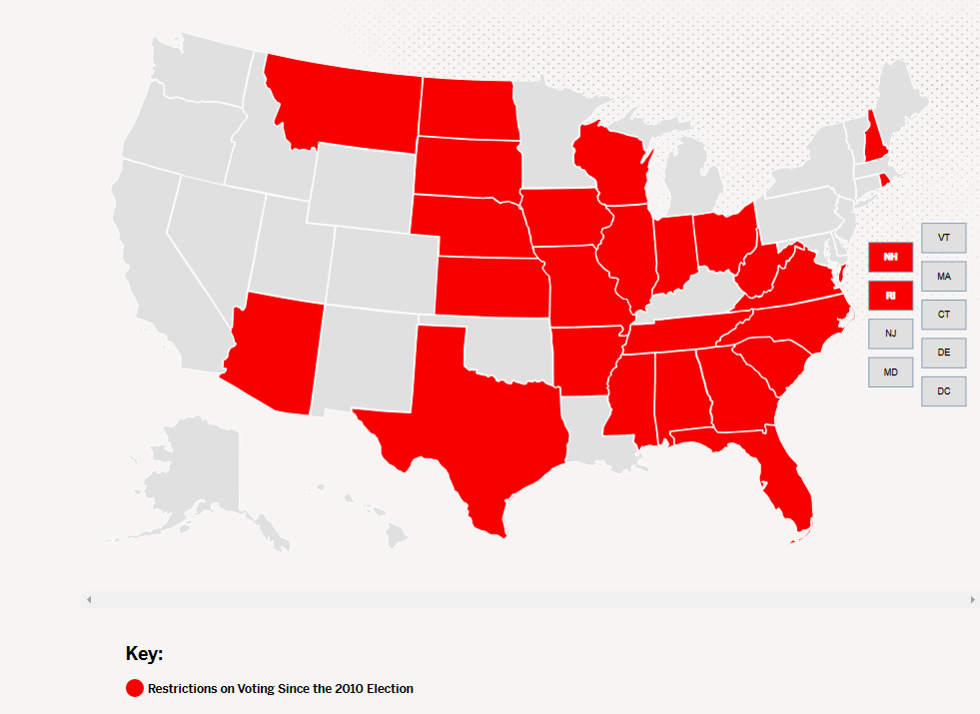
Eliminate Voting Restrictions in America
Since 2010, 25 states have put in place measures to make it harder to vote
------------
15 states with restrictive voter IDs
12 states with voter registration restrictions
10 states with early or absentee voting limits
3 states made it harder to restore voting rights for ex-felons
Source: Brennan Center for Justice, New Voting Restrictions in America at https://www.brennancenter.org/new-voting-restrictions-america

Slide 92

Questions

Slide 93
Community Action Census Team
Partnership Staff
Lindsay Marsh, Project Director LMarsh@CommunityActionPartnership.com
Lil Dupree, Senior Associate – Research LDupree@CommunityActionPartnership.com

Slide 94


Community Action Census Team
Subject Matter Experts
Center for Community Futures
Jim Masters
JMasters@cencomfut.com
Allen Stansbury
Allen@stansbury.net

